Slide 1
CS5220 Advanced Topics in Web Programming
Course Overview
Chengyu Sun
California State University, Los Angeles

Slide 2
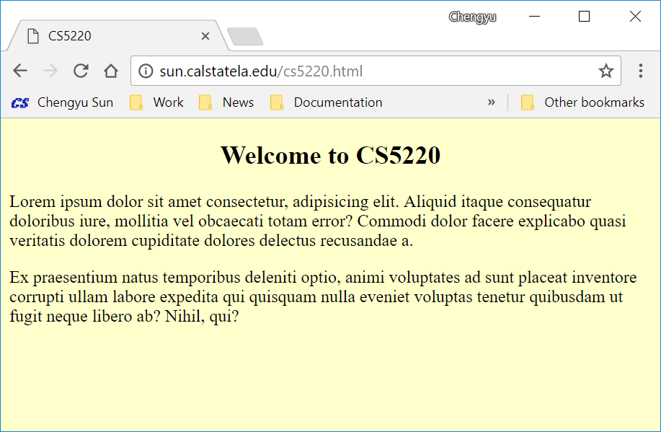
Static Web Page

Slide 3
How the Web Works
http://sun.calstatela.edu/cs5220.html
HTTP Server
Browser
HTTP request
HTTP response
/var/www/html
cs5220.html
Client
Server

Slide 4
Dynamic Content
Web search results
Shopping cart
…
Anything that need to be generated on the fly based on user request

Slide 5
Produce Dynamic Content
Application Server
Browser
HTTP request
HTTP response
input
output
Client
program
Server

Slide 6
CGI – Perl
#!/usr/bin/perl
print "Content-type:text/html\n\n";
print '<html>';
print '<head>';
print '<title>Hello</title>';
print '</head>';
print '<body>';
print '<h2>Hello World in CGI!</h2>';
print '</body>';
print '</html>';

Slide 7
Embed Code in HTML – JSP
<!DOCTYPE html>
<html>
<body>
<% if( Math.random() < 0.5) { %>
<h1>Have a nice day!</h1>
<% } else { %>
<h1>Have a lousy day!</h1>
<% } %>
</body>
</html>

Slide 8
Embed Code in HTML – ASP
<!DOCTYPE html>
<html>
<body>
<%
If hour(time) < 10 Then
response.write("Good morning!")
Else
response.write("Have a nice day!")
End If
%>
</body>
</html>

Slide 9
Embed Code in HTML – PHP
<!DOCTYPE html>
<html>
<body>
<?php
if (date("H") < "20") {
echo "Have a good day!";
} else {
echo "Have a good night!";
}
?>
</body>
</html>

Slide 10
The Problem with “Page with Code”
Mixing presentation with processing – makes the application hard to read, test, reuse, or maintain

Slide 11
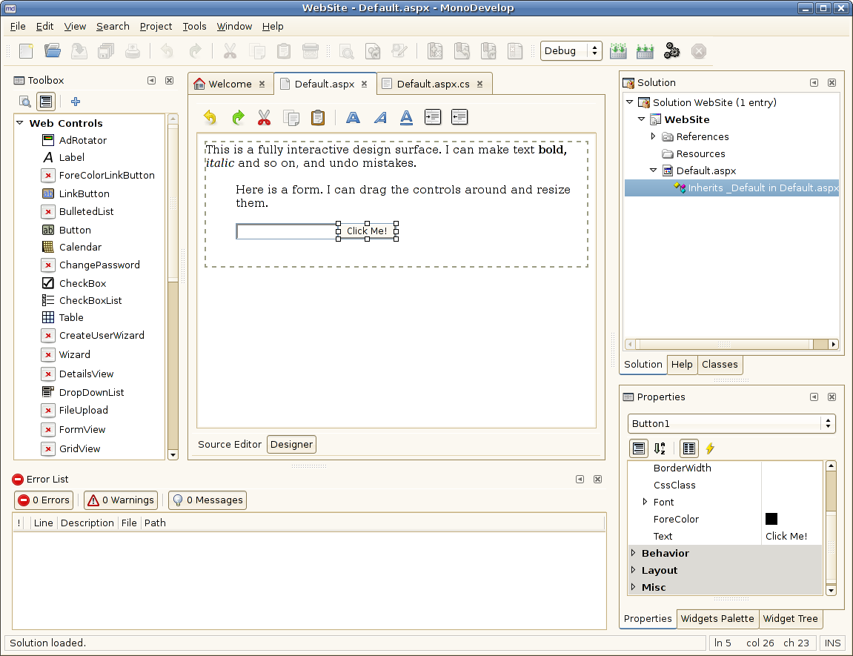
GUI Components + Event Handling Approach …

Slide 12
… GUI Components + Event Handling Approach
ASP.NET, GWT, JSF
Advantages:
  Pre-built GUI components
  Visual Designer
  Similar to developing desktop applications
Disadvantages: see Advantages

Slide 13
The MVC Architecture
model
controller
browser
view
Client
Server

Slide 14
MVC Web Frameworks
Spring, Struts for Java
ASP.NET MVC for C# and VB
Zend for PHP
Express for JavaScript
Django for Python
Rails for Ruby

Slide 15
RESTful Web Service + Client
Desktop
Application
RESTful
Web
Service
Mobile App
Web
Application
Single Page
Application (SPA)

Slide 16
Benefits of REST + Client
One backend serves multiple types of frontend
RESTful web service is more scalable than traditional web applications

Slide 17
Course Overview
Frontend
SPA
UI Lib
Project Management &
Collaboration
REST API
Security
Deployment
Web Framework
Data Modeling & Access

Slide 18
Project Management and Collaboration
Build and build tools
  Make, Ant, Maven, NPM
Version control
  Git and GitHub

Slide 19
Data Modeling and Access …
Relational Database
  PostgreSQL/MySQL
NoSQL Database
  MongoDB
ORM and ODM
  JPA, Hibernate, Mongoose

Slide 20
… Data Modeling and Access
Full Text Search (FTS)
  Database-provided FTS
    PostgreSQL/MySQL, MongoDB
  Standalone solutions
    Lucene, Elasticsearch

Slide 21
Web Services
Traditional web services
  SOAP, WSDL, UDDI
RESTful web services

Slide 22
Web Frameworks
Frameworks
  Spring (Java)
  Express (Node.js)
Implementing RESTful web services (a.k.a REST API)
Other common tasks
  Logging, testing, validation, file upload, email …

Slide 23
Frontend
Single Page Application
  Angular
UI libraries
  Bootstrap

Slide 24
Security and Deployment
Web application security
  Spring Security (Spring)
  Passport (Express)
  JWT
Deployment
  Deployment on servers and cloud services

